Slide 1
Logistic Regression
Tag - J

Slide 2


Let's get started!
Are you ready?

Slide 3



3
The factor that is being predicted is called the dependent variable. The factors that are used to predict the value of the dependent variable are called the independent variables.​
Linear regression models are used to show or predict the relationship between two variables or factors.
In linear regression, each observation consists of two values. One value is for the dependent variable and one value is for the independent variable.
In this simple model, a straight line approximates the relationship between the dependent variable and the independent variable.

Slide 4




3
When two or more independent variables are used in regression analysis, then the model is known as multiple regression.

Slide 5


What is Logistic Regression?

Slide 6
Logistic regression is a supervised learning classification algorithm used to predict the probability of a target variable.
The nature of target or dependent variable is dichotomous, which means there would be only two possible classes.​
04

Slide 7
2
Mathematically, a logistic regression model predicts P(Y=1) as a function of X.
1
3
The dependent variable is binary in nature having data coded as either 1 (stands for success/yes) or 0 (stands for failure/no).​
It is one of the simplest ML algorithms that can be used for various classification problems such as spam detection, Diabetes prediction, cancer detection etc.​

Slide 8
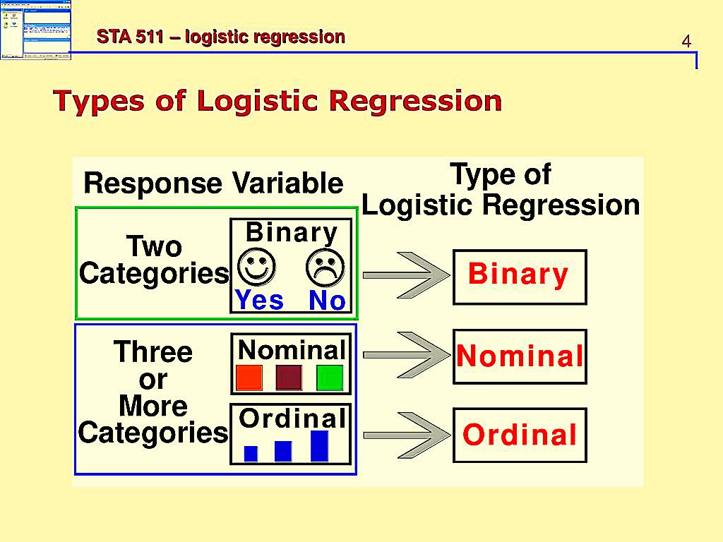




Slide 9



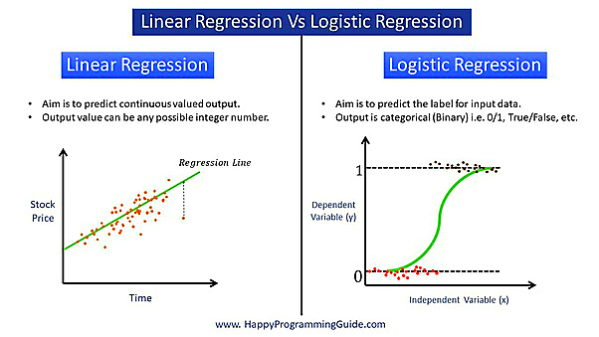

Difference

Slide 10




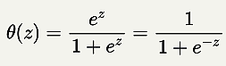
Sigmoid Function
Sigmoid Function
Let z be any continuous value whose domain is (-∞,∞).
If you plug z into the sigmoid function like
A nice property of the output is that it is always within 0 and 1.

Slide 11

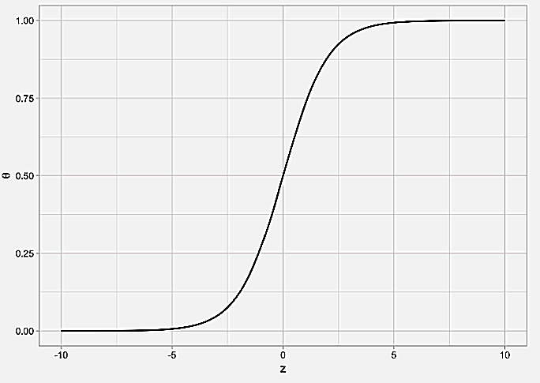

Sigmoid Function

Slide 12


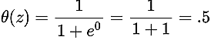
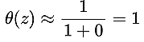
Here are some properties of θ(z):
When z is very large, θ is approximately 1
When z = 0, θ =0.5

Slide 13

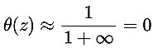
3.When z is very small/negative, θ is approximately 0
We can use the sigmoid function to convert a continuous, unbounded output z to a decimal number θ ∈ (0,1), which is advantageous for representing probabilities.

Slide 14




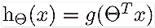
Cost Function
Linear Regression
Logistic Regression
Logistic Regression,

Slide 15

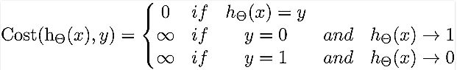
Cost Function
To fit parameter θ, J(θ) has to be minimized and for that Gradient Descent is required.

Slide 16
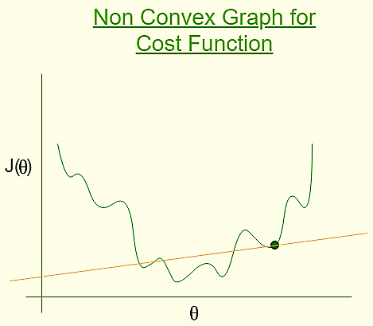




Slide 17
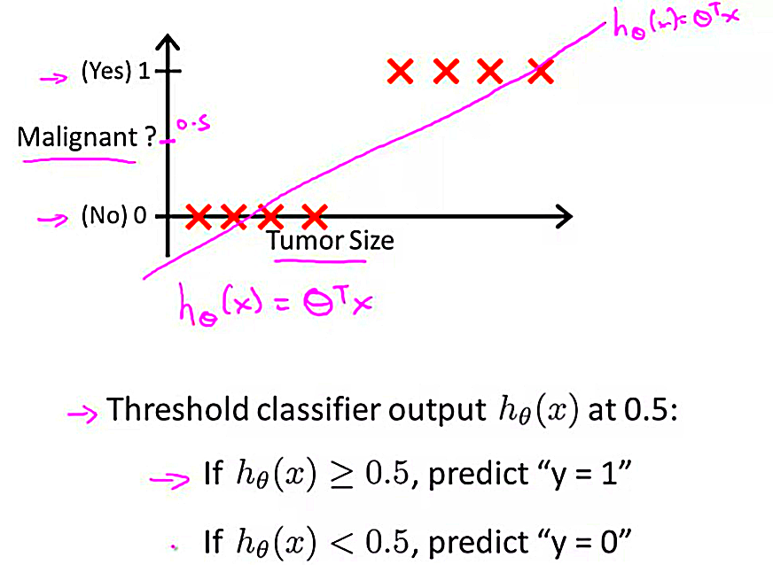
Examples
Let us consider an example of cancer prediction whether it is malignant or not.And label Malignant or not on y-axis and tumor size on x-axis.
In linear regression:
h(x) is proportional to tumor size
And h(x) depends on training set

Slide 18
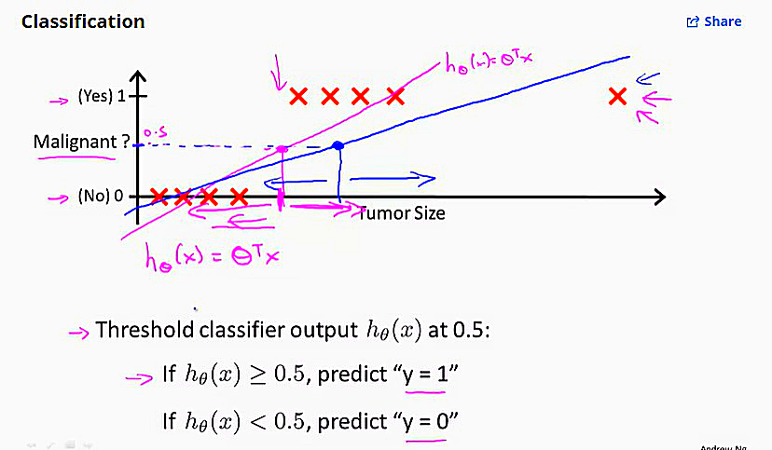

Because of this, we loose the accuracy in prediction whether it is malignant or not.
And also h(x)>1 and h(x)<0 which is unbound
So we need a function that makes 0<=h(x)<=1
So we use Logistic regression for classification problems

Slide 19
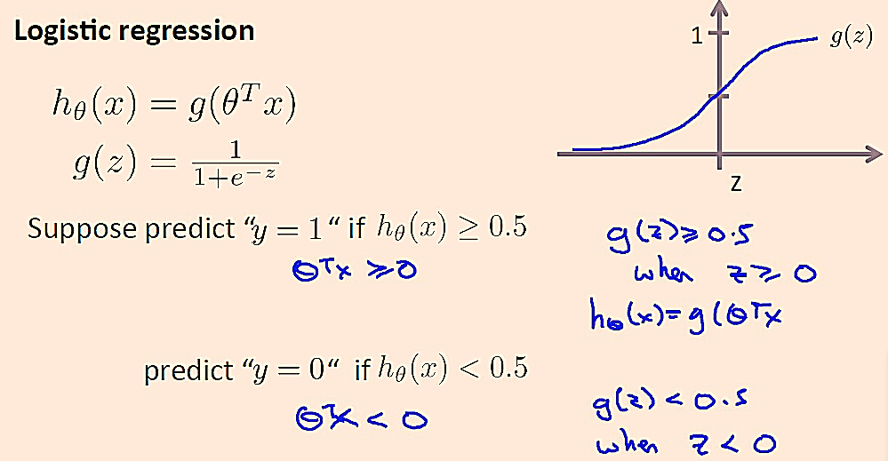

In Logistic Regression:

Slide 20

Advantages
Logistic regression is easier to implement, interpret, and very efficient to train
It makes no assumptions about distributions of classes in feature space
It can easily extend to multiple classes(multinomial regression) and a natural probabilistic view of class predictions.
It not only provides a measure of how appropriate a predictor(coefficient size)is, but also its direction of association (positive or negative)..

Slide 21


If the number of observations is lesser than the number of features, Logistic Regression should not be used, otherwise, it may lead to overfitting.
It constructs linear boundaries.
The major limitation of Logistic Regression is the assumption of linearity between the dependent variable and the independent variables.
It can only be used to predict discrete functions. Hence, the dependent variable of Logistic Regression is bound to the discrete number set.
Disadvantages

Slide 22




Thank you!
Have a great day ahead.

